Slide 1
Apache Kafka:
Powering Real-Time Data Pipelines and Event-Driven Architectures

Slide 2
Agenda
01. Introduction
02. Historical Background
03. Development and need for Kafka
04. Architecture
05. Demo

Slide 3
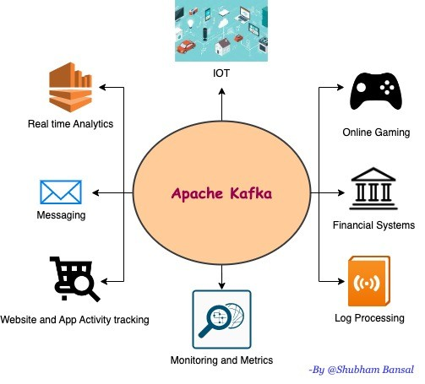
Kafka
The topic of our term paper is Apache Kafka. It is an open-source distributed event streaming
platform used by thousands of companies for high-performance data pipelines, streaming
analytics, data integration, and mission-critical applications
Examples:
Ingesting clickstream data from websites into storage (e.g., S3, Snowflake, BigQuery).
Streaming IoT sensor data into analytics systems.
Sending data from microservices to analytics dashboards.

Slide 4
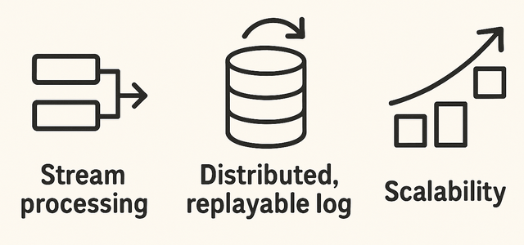
Kafka: Who, When and Why?
Kafka was originally created at LinkedIn in 2010 by engineers Jay Kreps, Neha Narkhede, and Jun Rao, who were frustrated by the limitations of traditional messaging systems like ActiveMQ and RabbitMQ in handling the massive scale of LinkedIn’s data pipelines.
ActiveMQ and RabbitMQ could handle thousands of messages per second, but LinkedIn needed to handle millions. These systems stored messages in memory or relational databases, causing severe slowdowns under high load. Kafka, in contrast, writes messages sequentially to disk and batches network I/O, allowing near–file-system-level performance. Their goal was to design a platform capable of ingesting billions of events per day, ranging from user activity logs and clickstream data to recommendation engine signals, while providing strong guarantees around scalability, durability,
and fault tolerance. This internal project was open-sourced under the Apache Software Foundation in 2011.

Slide 5
Kafka: Who, When and Why?
Feature | Traditional Messaging | Kafka
Scalability | Single broker or small cluster | Horizontally scalable across servers
Storage | Deletes after consumption | Persistent, replayable log
Speed | Thousands/sec | Millions/sec
Use cases | Notifications, transactions | Real-time data pipelines, analytics, ML
Integration | One-to-one | One-to-many
Notes:
Lack of Durable Storage
In existing brokers, messages were typically deleted once consumed, meaning you couldn’t reprocess data or recover from errors easily. LinkedIn needed persistent logs of all user activity for analytics, debugging, and machine learning. Kafka introduced the idea of an immutable, append-only commit log — data is retained for a configurable time, enabling replay and reprocessing at any time.
Poor Scalability and Fault Tolerance
Old messaging systems ran as single brokers or limited clusters, making horizontal scaling painful. LinkedIn’s data volume demanded distributed partitioning — splitting topics across servers for parallel processing — and replication for fault tolerance. Kafka was designed to scale linearly with more brokers, partitions, and consumers without coordination overhead.
raditional systems enforced a strict “send-and-forget” model — once a consumer read a message, it was gone. That made it impossible for multiple applications to consume the same stream independently.
Kafka decoupled producers and consumers through topic partitions: producers write once, and any number of consumers can read at their own pace without interfering. No Stream Processing or Real-Time Analytics Capability
LinkedIn wanted to go beyond data movement — they needed real-time analytics, like counting clicks or generating trending topics on the fly. Kafka’s architecture laid the groundwork for stream processing frameworks (Kafka Streams, ksqlDB) that could transform, filter, and aggregate data as it flowed through the system.
Operational Simplicity and Reliability
Running hundreds of ActiveMQ or RabbitMQ instances was complex. Failures often led to message loss or inconsistent state. Kafka was designed for distributed resilience — it automatically handles broker failures through leader–follower replication and ensures data consistency via commit offsets.

Slide 6
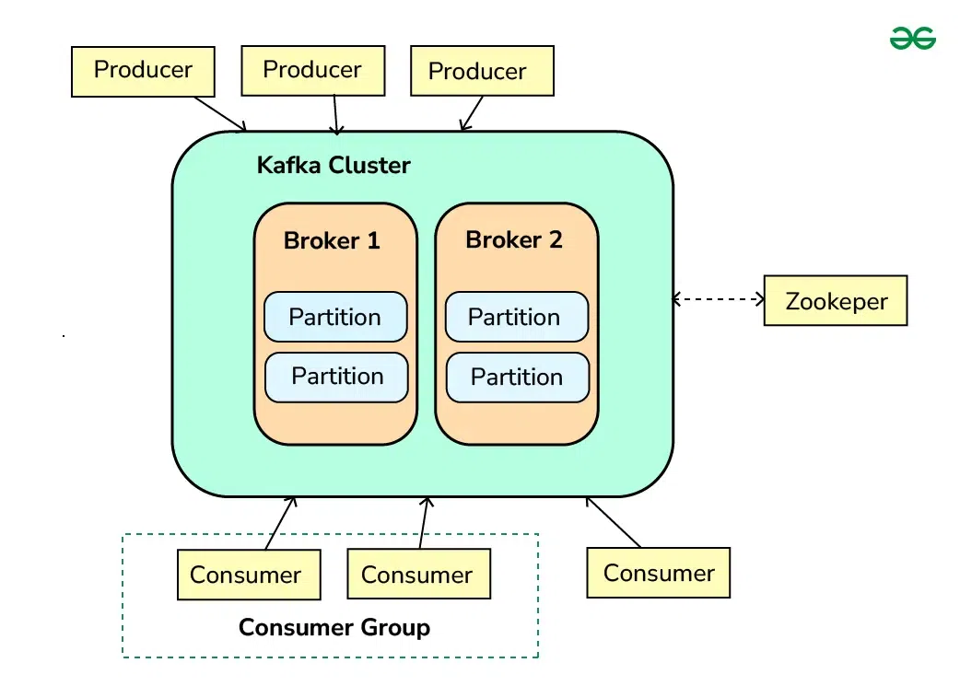
Kafka Architecture
Producers send data (events) into the Kafka Cluster.
The cluster is made up of multiple brokers (servers) that store data.
Each broker holds partitions, which keep messages in order for fast access.
Consumers read data from these partitions, often as part of a consumer group to share the load.
ZooKeeper (or KRaft in newer versions) manages coordination and health of brokers.
Together, this design makes Kafka scalable, fault-tolerant, and real-time.

Slide 7
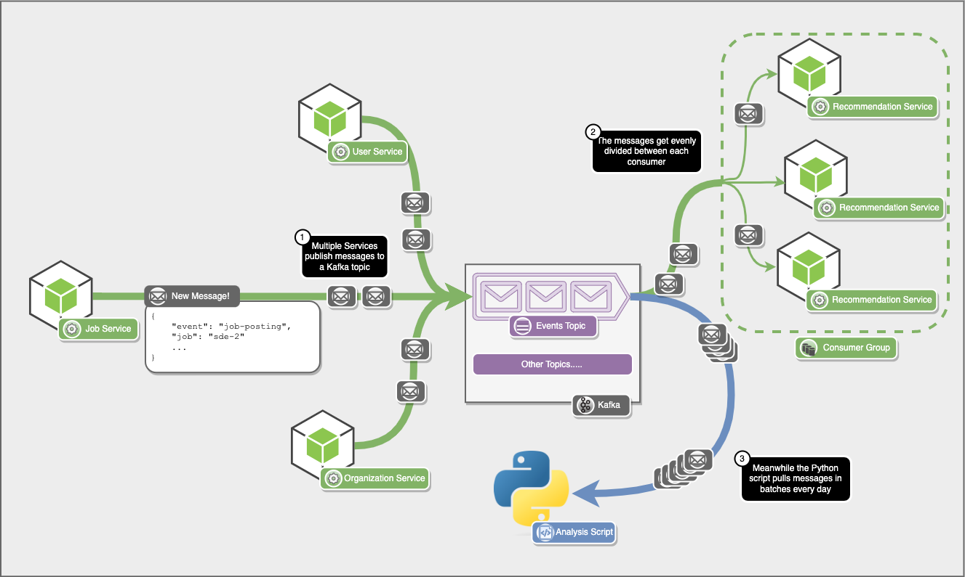
Multiple services like the Job, User, and Organization services generate events (such as job postings) and publish them to a Kafka topic. Kafka acts as a central event hub, storing and streaming these messages in real time. A consumer group (the Recommendation Service instances) subscribes to this topic, and Kafka evenly distributes messages across them for parallel processing. Meanwhile, other consumers, like a Python analysis script, can independently pull and process the same data later — showing Kafka’s ability to support both real-time and batch processing simultaneously.
Notes:
Kafka doesn’t rely on MySQL, Postgres, or any external database to store messages.
Instead, it stores data directly on disk (inside the Kafka brokers themselves) using a highly optimized log-based storage format. How it works:
Each Kafka topic is split into partitions, and each partition is an append-only log file on disk.
New messages are appended sequentially, which is extremely fast — even faster than random writes to databases.
These logs are stored in the Kafka brokers’ local file system, replicated across multiple brokers for fault tolerance.
Data is kept for a configurable retention period (e.g., 7 days, 30 days, or indefinitely).

Slide 8
Kafka Techniques & Approaches
1. Distributed Publish–Subscribe System Kafka enables multiple producers and consumers to exchange data in real time through topics — allowing systems to remain loosely coupled and highly scalable.
2. Partitioning for Parallelism Topics are divided into partitions, letting multiple brokers handle data simultaneously. This ensures high throughput and load balancing across servers.
3. Replication for Reliability Each partition has replicas across brokers to prevent data loss and support fault-tolerant recovery in case of hardware or network failures.
4. Stream Processing Capability Kafka Streams API supports filtering, aggregating, and transforming messages in real time, turning raw events into actionable insights.
5. Seamless Integration Kafka connects easily with Spark, Flink, and Hadoop ecosystems, making it central to real-time analytics and event-driven architectures.

Slide 9
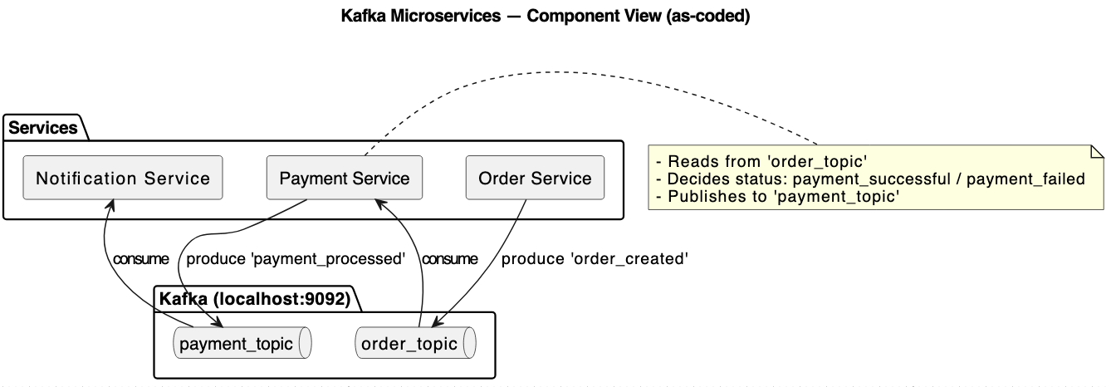
Demo Architecture

Slide 10
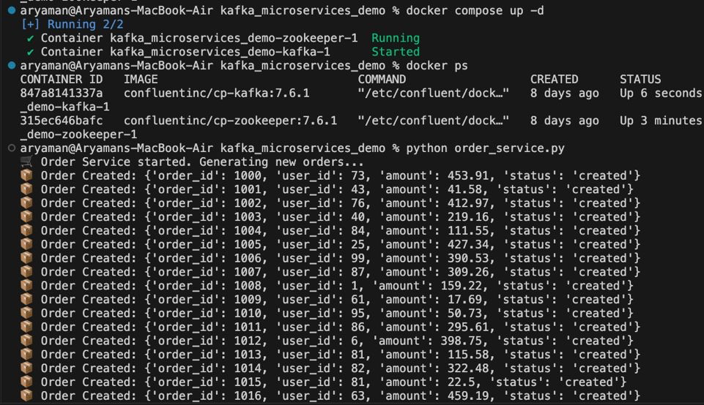
Sample Output

Slide 11
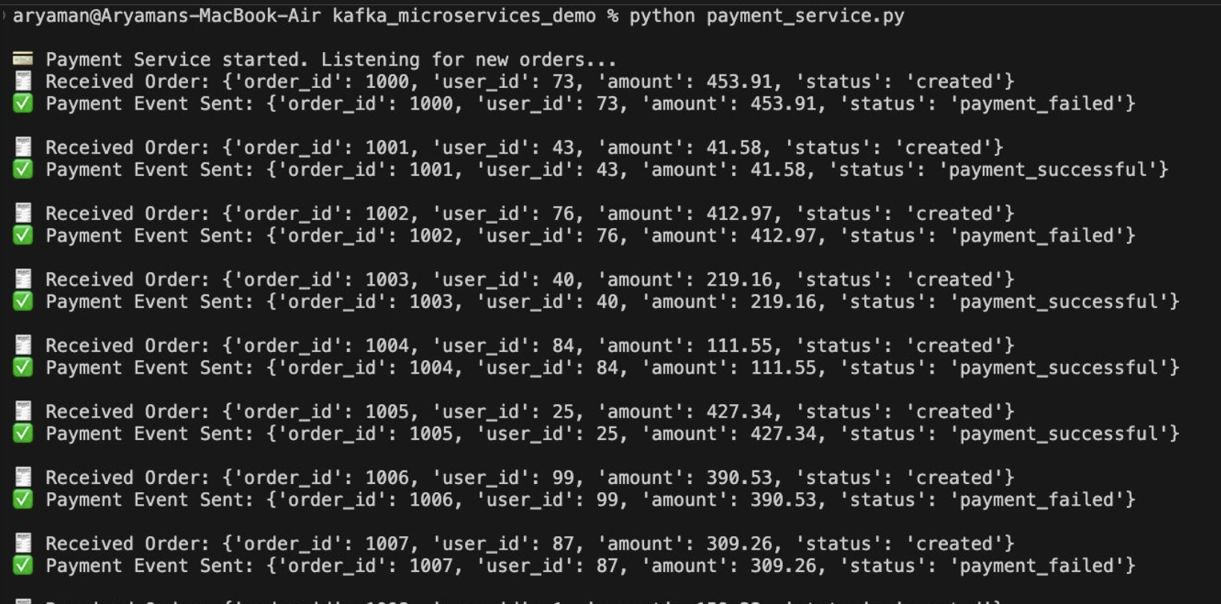
Sample Output

Slide 12
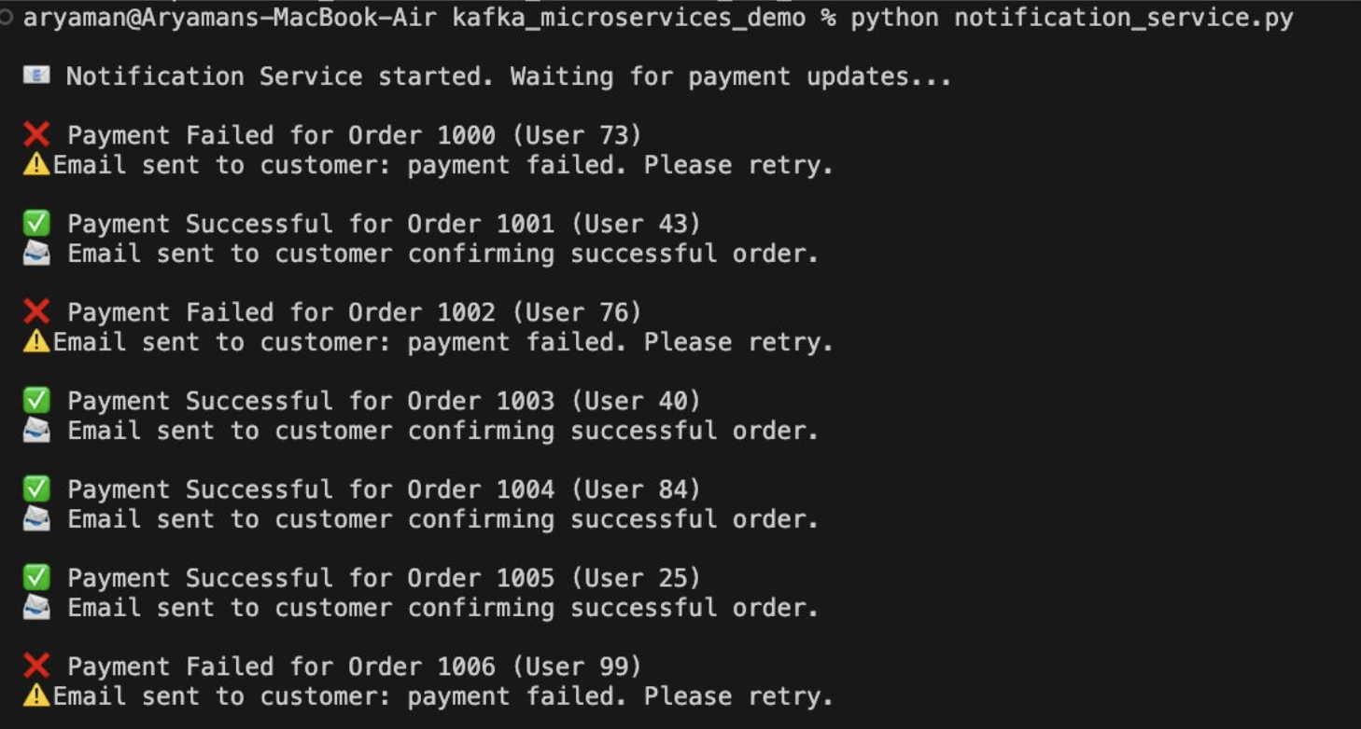
Sample Output

Slide 13
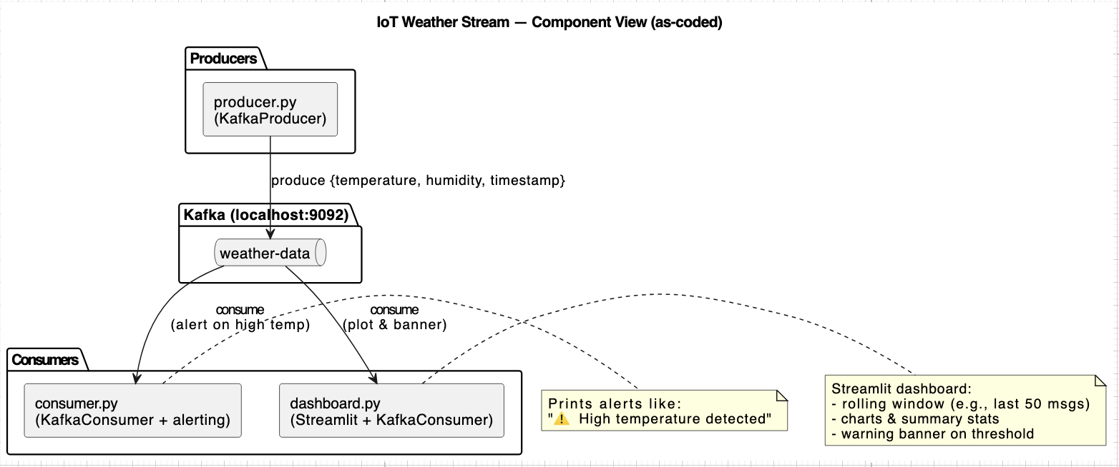
Demo Architecture

Slide 14
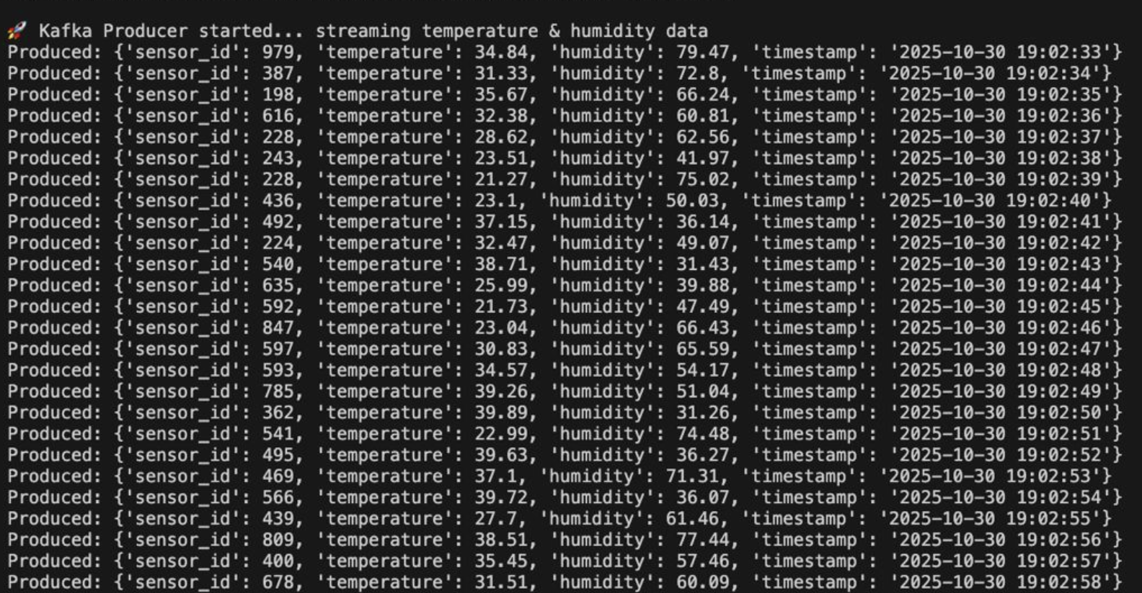
Sample Output

Slide 15
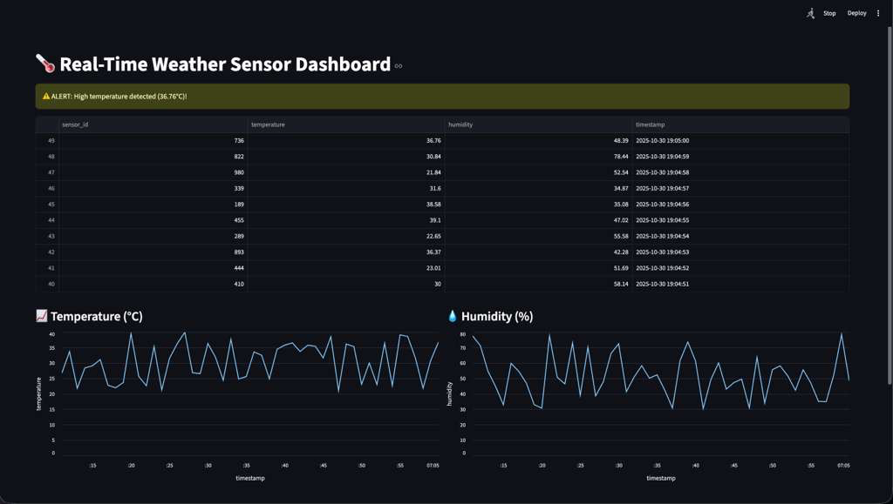
Sample Output

Slide 16
Thank you!

